Slide 1
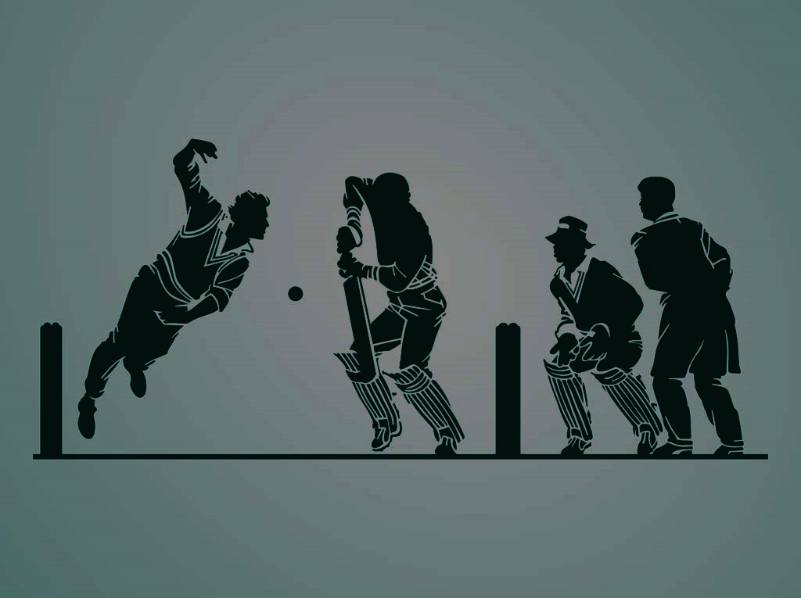
CRICKET ANALYSIS BATSMAN PERFORMANCE PREDICTION
PRESENTED BY:
SATHIYAMOORTHI G

Slide 2

TABLE OF CONTENT
1.MATHEMATICAL COMPUTATION
1.1.SPLIT DATA
1.2.FANTASY POINTS SYSTEM
1.3 PLAYER’S BALL BY BALL PERFORMANCE OF MATCH
1.3.1 PLAYER PERFORMANCE
1.3.2 FORMULA (PARTIAL DERIVATIVE)
1.3.3 CALCULATIONS
1.4 INDIVIDUAL PERFORMANCE AT THE END OF MATCH
1.5 PLAYER’S AVERAGE PERFORMANCE
1.6 PLAYER’S ROLLING AVERAGE PERFORMANCE
1.7 PREPARE ML DATASET
2. PROCESS OF EXPLORATORY DATA ANALYSIS
2.1 HANDLING MISSING VALUES
2.2 HANDLING OUTLIERS USING IQR METHOD
2.3 GETTING USEFUL INSIGHTS AT THE END OF EDA
3. CONCLUSION AND INTERPRETATION
4. FUTURE DEVELOPMENT

Slide 3

1.MATHEMATICAL COMPUTATION
SPLIT DATA
FANTASY POINTS SYSTEM
PLAYER’S BALL BY BALL PERFORMANCE OF MATCH
INDIVIDUAL PERFORMANCE AT THE END OF MATCH
PLAYER’S AVERAGE PERFORMANCE
PLAYER’S ROLLING AVERAGE PERFORMANCE
PREPARE ML DATASET

Slide 4

1.1.SPLIT DATA
NUMBER OF SEASONS
NUMBER OF MATCHES
TOTAL NUMBER OF RECORDS
PROCESSED DATASET FOR ML ALGORITHM
15
950
225954
14229
Split the data using match ID

Slide 5

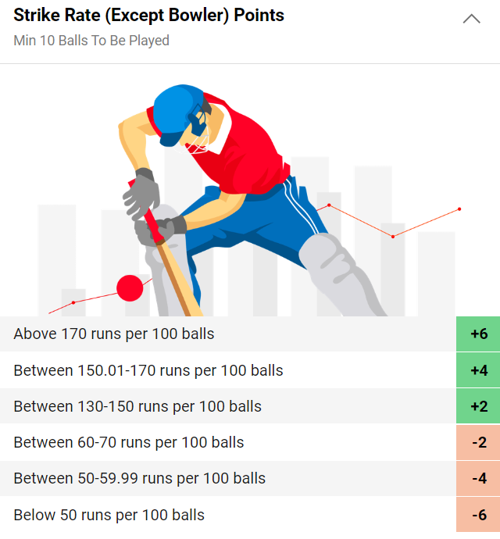
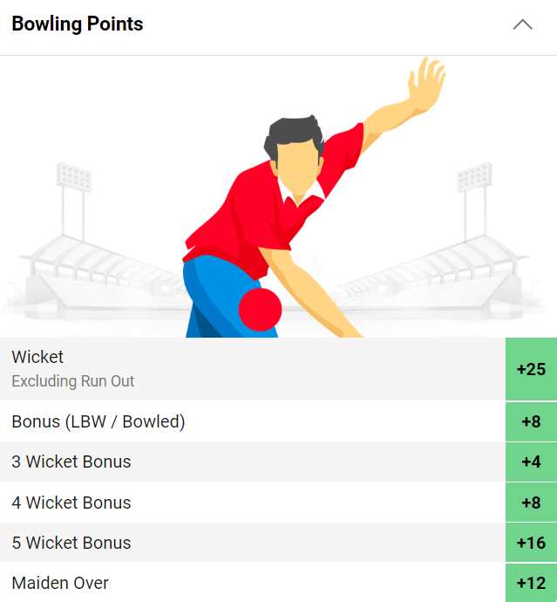
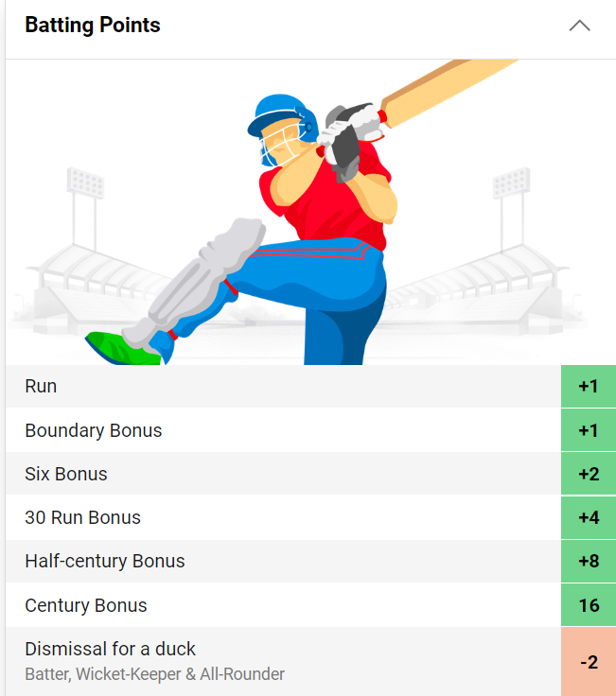
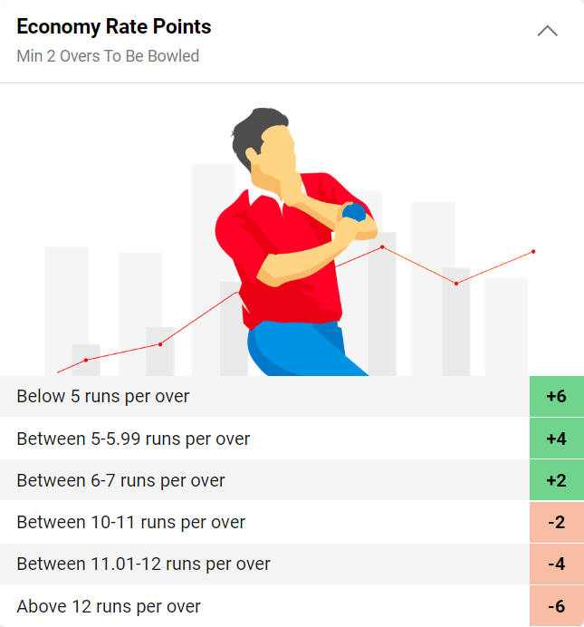
1.2.FANTASY POINTS SYSTEM
SOURCE - Link

Slide 6
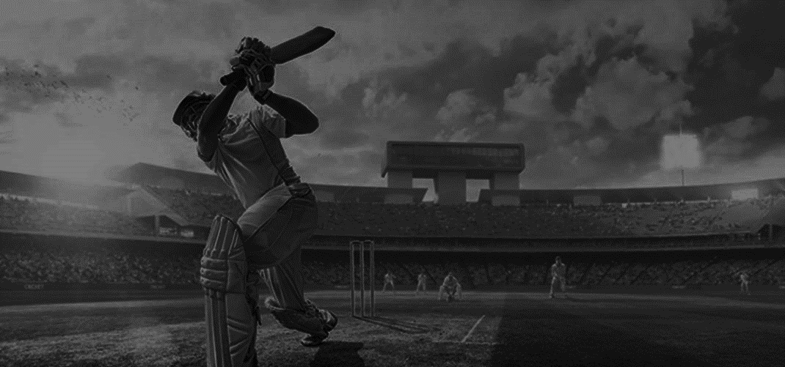
Any player scoring a century will only get points for the century. No points will be awarded as their 30 run Bonus or Half-century Bonus. Additionally, no points are awarded for centuries in T10 matches.
If any runs are scored on an overthrow, points for those runs will be credited to the batter on strike for that ball. However, if the overthrow goes for a boundary, the batter will not receive extra Boundary Bonus points.
Negative points for low batting Strike Rates are only applicable for individual Strike Rates of 70 runs per 100 balls or below.

Slide 7


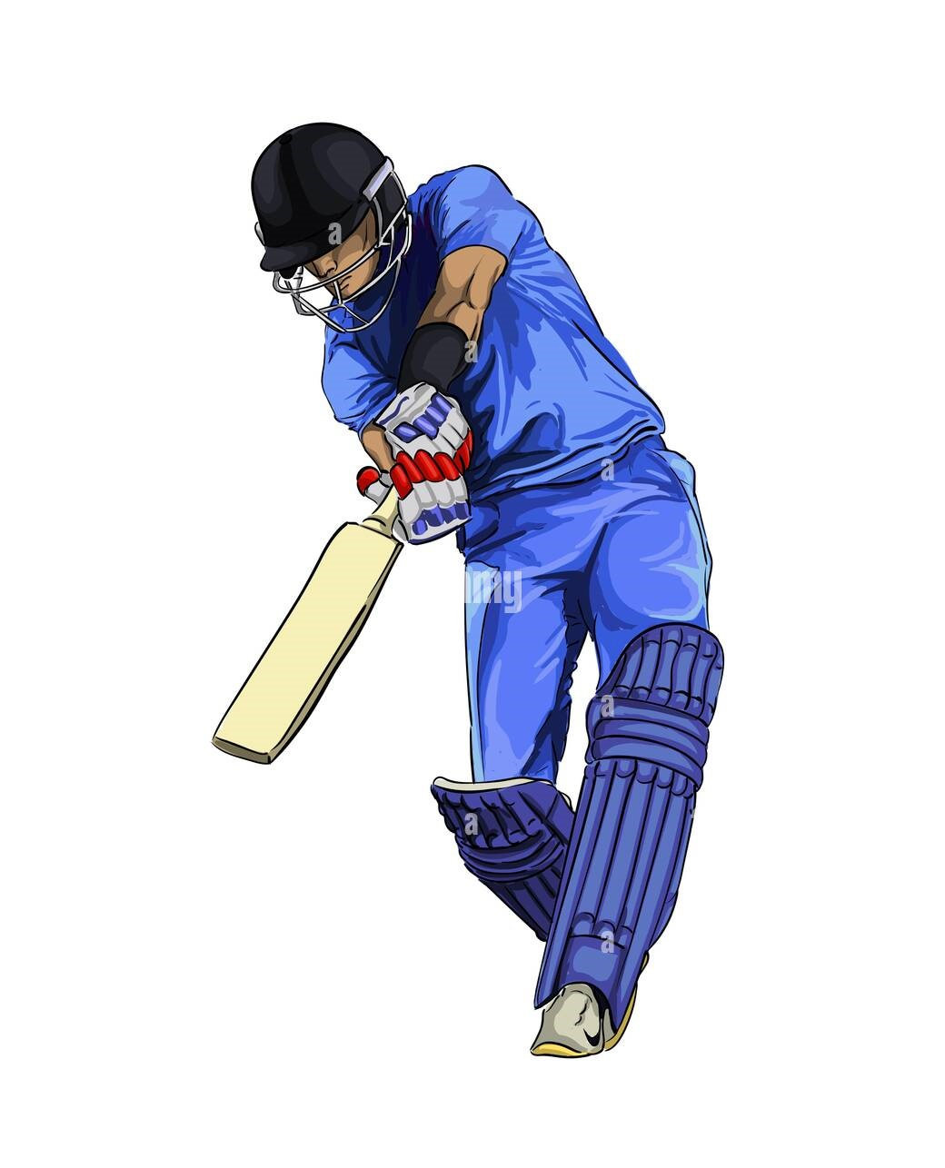
1.3 PLAYER’S BALL BY BALL PERFORMANCE OF MATCH
1.3.1 PLAYER PERFORMANCE
Batsman 1
Points = -3
Performance = 110
Bowler 1
Points = 3
Performance = 110
Ball No.1
Batsman 2
Points=1
Performance = 110
Bowler 1
Points = 5
Performance = 113
Ball No.2
Ball No.3
Batsman 1
Points = -1
Performance = ?
Bowler 1
Points = 4
Performance = ?

Slide 8

1.3.2 FORMULA (PARTIAL DERIVATIVE)
Batsman difference = Batsman current point – Batsman before point
Bowler difference = Bowler current point – Bowler before point
Change of batsman = Batsman difference / |Bowler difference|
Change of bowler = Bowler difference/ |Batsman difference|
Batsman performance = Batsman before performance + Change of batsman
Bowler performance = Bowler before performance + Change of bowler

Slide 9
1.3.3 CALCULATIONS
Batsman difference = -1 - (-3) = 2
Bowler difference = 4 - 5 = -1
Change of batsman = 2 / |-1| = 2
Change of bowler = -1 / |2| = -0.5
Batsman performance = 110 + 2 = 112
Bowler performance = 113 + (-0.5) = 112.5

Slide 10
1.4 INDIVIDUAL PERFORMANCE AT THE END OF MATCH
Players individual performance is calculated by the above method for each matches
1.5 PLAYER’S AVERAGE PERFORMANCE
Players individual average performance is calculated from 2008 to 2022
1.6 PLAYER’S ROLLING AVERAGE PERFORMANCE
Players individual average performance is calculated for the past 3 matches.

Slide 11

1.7 PREPARE ML DATASET
VENUE
INNINGS
BATSMAN NAME
BATSMAN ROLLING AVERAGE
PLAYER TYPE
TEAM
OPPONENT TEAM
BATTING POSITION
BOWLERS ROLLING AVERAGE
BATSMAN PERFORMANCE

Slide 12

VENUE – Stadium where the match held
INNINGS – At what innings the batsman were played (i.e. 1 or 2)
BATSMAN NAME – Name of the batsman
BATSMAN ROLLING AVERAGE – Batsman rolling average performance for at least past 3 matches
PLAYER TYPE – Defines the type of player (i.e. Batsman or All-rounder or Bowler)
BATTING STYLE - Defines the style of the batsman (i.e. Right hand or Left hand )
TEAM – Which team, Batsman had played
OPPONENT TEAM – Which team, Batsman had faced
BATTING POSITION – At what order, Batsman had played (i.e. 1 to 11)
BOWLERS ROLLING AVERAGE – Opponent Bowler’s rolling average performance for at least past 3 matches
BATSMAN PERFORMANCE – Player performance at that match

Slide 13

2. PROCESS OF EXPLORATORY DATA ANALYSIS
Handling missing values
Getting useful insights from bivariate analysis graph
Handling outliers using IQR method
Study correlation between the features

Slide 14

2.1 HANDLING MISSING VALUES
we can fill the missing values with the corresponding opponent team mean in the respective features
2.2 HANDLING OUTLIERS USING IQR METHOD
Here we can handle the outlier using IQR with
max= Q3 + 3 * IQR .
It will remove only extreme outliers.
Handling Outliers with respect to Venue
Handling Outliers with respect to Type
Handling Outliers with respect to Batting Style
Handling Outliers with respect to Team
Handling Outliers with respect to Opponent

Slide 15
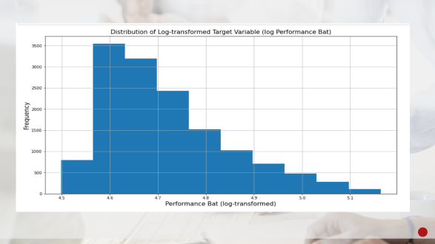
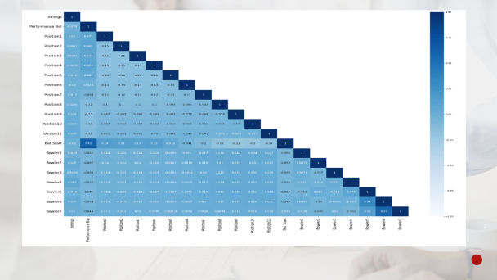
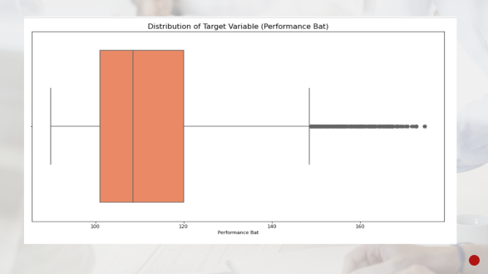
2.3 GETTING USEFUL INSIGHTS AT THE END OF EDA

Slide 16
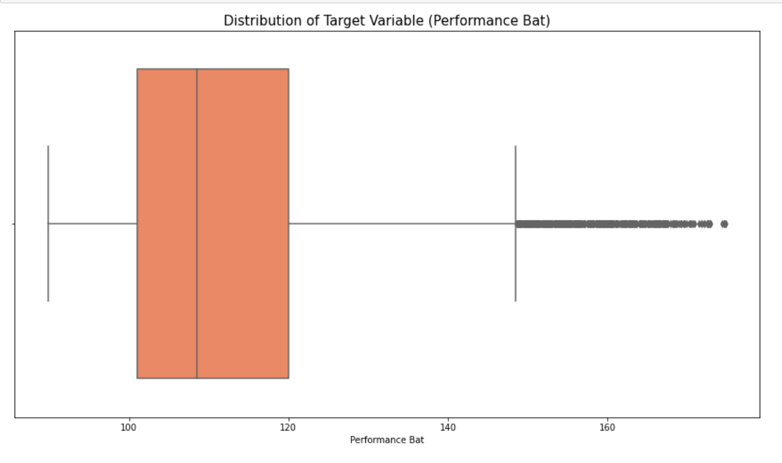

Slide 17
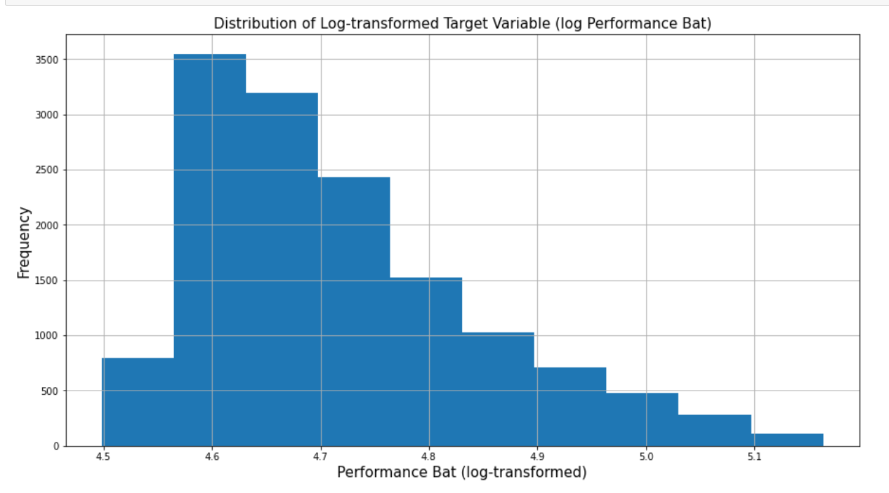

Slide 18
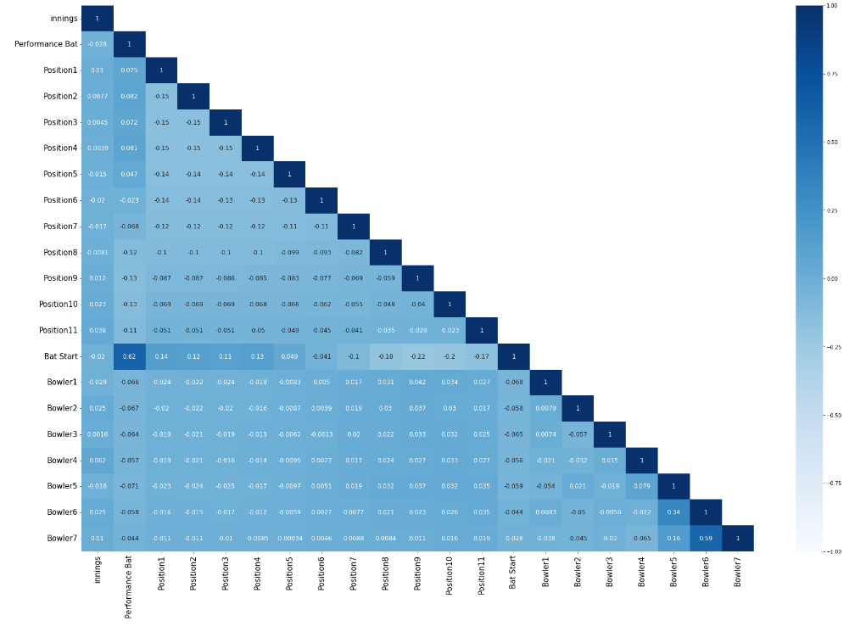
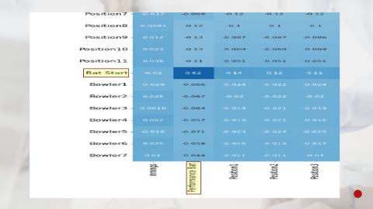

Slide 19
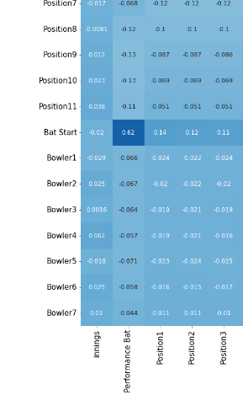

Slide 20
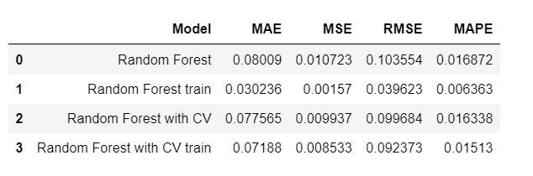
3. CONCLUSION AND INTERPRETATION

Slide 21
4. FUTURE DEVELOPMENT
The model can provide reports and recommendations to improve team performance or reduce opponent performance by using mathematical computations in the future.
We can use python pipelines to get concise code in python

Slide 22





THANK YOU!
Sathiyamoorthi G
sathiyag0512@gmail.com
+91 6380355017
LinkedIn

